Slide 1


CM1602 : Data Structures and Algorithms for AI
9. Graph Algorithms
Lecture 9 | R. Sivaraman

Slide 2
MODULE CONTENT
Lecture | Topic
Lecture 01 | Introduction to Fundamentals of Algorithms
Lecture 02 | Analysis of Algorithms
Lecture 03 | Array and Linked Lists
Lecture 04 | Stack
Lecture 05 | Queue
Lecture 06 | Searching algorithms and Sorting algorithms
Lecture 07 | Trees
Lecture 08 | Maps, Sets, and Lists
Lecture 09 | Graph algorithms
8/14/2020
Module Code Module Name
2

Slide 3
Learning Outcomes
LO1 : Describe the fundamental concepts of algorithms and data structures.
On completion of this lecture, students are expected to be able to:
Describe Graphs and when Graphs are used.
Describe the types of Graphs.
Describe Graph Algorithms.
3/30/2021
CM1602 : Data Structures and Algorithms for AI
3

Slide 4
Graph
A Graph is a non-linear data structure consisting of nodes and edges.
The nodes are sometimes also referred to as vertices and the edges are lines or arcs that connect any two nodes in the graph.
A Graph consists of a finite set of vertices(or nodes) and set of Edges which connect a pair of nodes.
Graphs have become a powerful means of modelling and capturing data in real-world scenarios such as social media networks, web pages and links, and locations and routes in GPS.
If you have a set of objects that are related to each other, then you can represent them using a graph.

Slide 6
Definitions Related to Graphs
Order: The number of vertices in the graph
Size: The number of edges in the graph
Vertex degree: The number of edges that are incident to a vertex
Isolated vertex: A vertex that is not connected to any other vertices in the graph
Self-loop: An edge from a vertex to itself
Directed graph: A graph where all the edges have a direction indicating what is the start vertex and what is the end vertex
Undirected graph: A graph with edges that have no direction
Weighted graph: Edges of the graph has weights
Unweighted graph: Edges of the graph has no weights

Slide 7
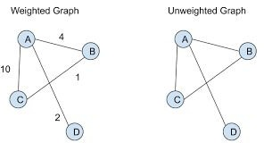
Types of Graphs

Slide 8
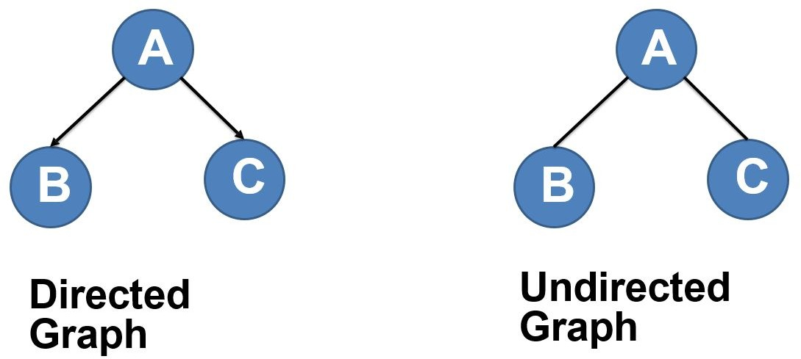
Types of Graphs

Slide 9
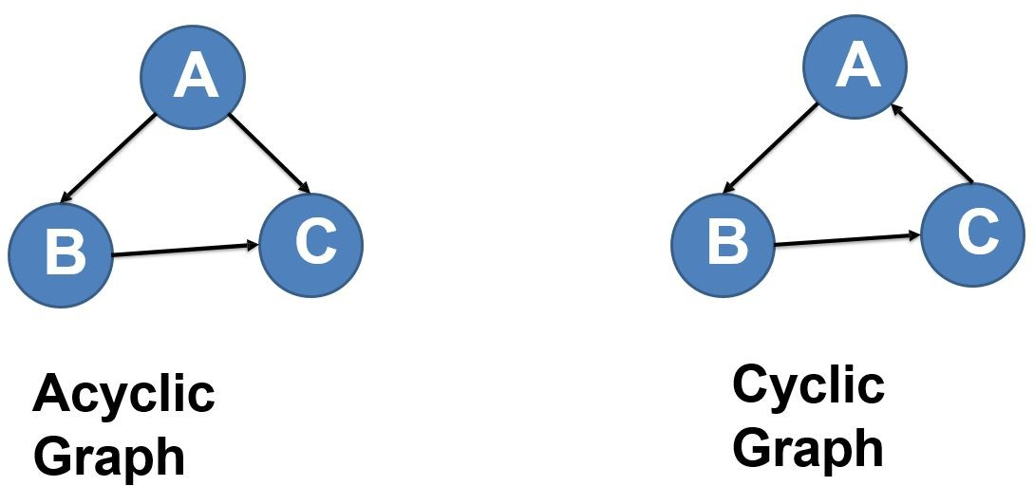
Types of Graphs

Slide 10
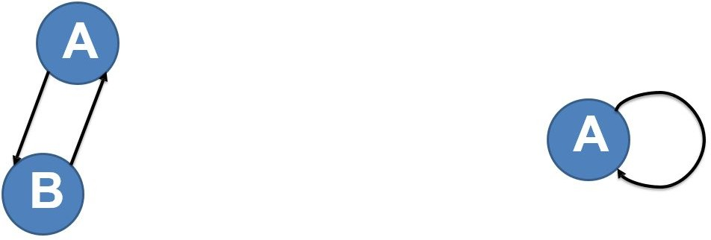
Types of Graphs
Backedge is an edge that is from node to itself (self loop), or one to its ancestor.

Slide 11
Breadth-first search (BFS)
In breadth-first search (BFS), we start at a particular vertex and explore all of its neighbors at the present depth before moving on to the vertices in the next level.
Unlike trees, graphs can contain cycles (a path where the first and last vertices are the same). Hence, we have to keep track of the visited vertices.
When implementing BFS, we use a queue data structure.

Slide 12
Breadth-first search (BFS) – (Slide show)

Slide 13
Breadth-first search (BFS) - Applications
Used to determine the shortest paths and minimum spanning trees.
Used by search engine crawlers to build indexes of web pages.
Used to search on social networks.
Used to find available neighbor nodes in peer-to-peer networks such as Bit Torrent.

Slide 14
Depth-first search (DFS)
In depth-first search (DFS) we start from a particular vertex and explore as far as possible along each branch before retracing back (backtracking).
In DFS also we have to keep track of the visited vertices.
When implementing DFS, we use a stack data structure to support backtracking.

Slide 15
Depth-first search (DFS) – (Slide show)

Slide 16
Depth-first search (DFS) - Applications
Used to find a path between two vertices.
Used to detect cycles in a graph.
Used in topological sorting.
Used to solve puzzles having only one solution (e.g., mazes)

Slide 17
Shortest path
The shortest path from one vertex to another vertex is a path in the graph such that the sum of the weights of the edges that should be travelled is minimum.
Figure shows an animation where the shortest path is determined from vertex 1 to vertex 6 in a graph.
Algorithms:
Dijkstra’s shortest path algorithm
Bellman–Ford algorithm

Slide 18
Shortest path - (Slide show)

Slide 19
Shortest path - Applications
Used to find directions to travel from one location to another in mapping software like Google maps or Apple maps.
Used in networking to solve the min-delay path problem.
Used in abstract machines to determine the choices to reach a certain goal state via transitioning among different states (e.g., can be used to determine the minimum possible number of moves to win a game).

Slide 20
Cycle detection
A cycle is a path in a graph where the first and last vertices are the same.
If we start from one vertex, travel along a path and end up at the starting vertex, then this path is a cycle.
Cycle detection is the process of detecting these cycles.
Algorithms:
Floyd cycle detection algorithm
Brent’s algorithm

Slide 21
Cycle detection - (Slide show)

Slide 22
Cycle detection - Applications
Used in distributed message-based algorithms.
Used to process large-scale graphs using a distributed processing system on a cluster.
Used to detect deadlocks in concurrent systems.
Used in cryptographic applications to determine keys of a message that can map that message to the same encrypted value.

Slide 23
Minimum spanning tree
A minimum spanning tree is a subset of the edges of a graph that connects all the vertices with the minimum sum of edge weights and consists of no cycles.
Algorithms:
Prim’s algorithm
Kruskal’s algorithm

Slide 24
Minimum spanning tree - (Slide show)

Slide 25
Minimum spanning tree - Applications
Used to construct trees for broadcasting in computer networks.
Used in graph-based cluster analysis.
Used in image segmentation.
Used in regionalization of socio-geographic areas, where regions are grouped into contiguous regions.

Slide 26
Topological sorting
Topological sorting of a graph is a linear ordering of its vertices so that for each directed edge (u, v) in the ordering, vertex u comes before v.
Figure shows an example of a topological ordering of vertices (1, 2, 3, 5, 4, 6, 7, 8). You can see that vertex 5 should come after vertices 2 and 3. Similarly, vertex 6 should come after vertices 4 and 5.
Algorithms:
Kahn’s algorithm
The algorithm based on depth-first search

Slide 27
Topological sorting - (Slide show)

Slide 28
Topological sorting
Applications
Used in instruction scheduling.
Used in data serialization.
Used to determine the order of compilation tasks to perform in make files.
Used to resolve symbol dependencies in linkers.

Slide 29
Maximum flow
We can model a graph as a flow network with edge weights as flow capacities.
In the maximum flow problem, we have to find a flow path that can obtain the maximum possible flow rate.
Algorithms
Ford-Fulkerson algorithm
Edmonds–Karp algorithm
Dinic’s algorithm

Slide 30
Maximum flow - (Slide show)

Slide 31
Maximum flow - Applications
Used in airline scheduling to schedule flight crews.
Used in image segmentation to find the background and the foreground in an image.
Used to eliminate baseball teams that cannot win enough games to catch up to the current leader in their division.

Slide 32
Additional Reading
Matching
Graph colouring
Strongly connected components

